Slide 1
School Safety and Security Ingrid Wiemer - Executive Director of Student Services Conrad Christensen – School Resource Officer
APT Meeting
2015-2016

Slide 2
Emergency Management Plan
Revised in 2012
Comprehensive Crisis Plan
Complies w/School Safety Drill Act
4 Phases of Emergency Management:
Mitigation/Prevention
2. Preparedness
3. Response
4. Recovery

Slide 3
Plan Components
Incidence Command System
Incident Scenarios
Functional Response Procedures
Communication Plans
Student and Visitor Accountability
Relocation and Reunification Procedures
School Maps
Psychological Aftermath of Trauma

Slide 4
Incident Topics
Student Abduction | Hazardous Spill | Missing Student | Explosion
Airplane Crash | Hostage Situation | Area Evacuation | Utility Failure
Use of AED | Natural Gas Leak | Civil Disobedience | Fire
Bus Accident | Sexual Assault | Flooding | National Threat Advisory
Child Abuse | Structural Damage | Fights on Campus | Food Contamination
Death in School | Suicide Behavior | Field Trips | Intruder w/Harmful Intent
Earthquake | Suspicious Mail | Storms

Slide 5
Response Procedures
School Evacuations (On-site, Off-site, Reverse) (3 drills required, 1 w/LFFD)
Shelter-in-Place (1 Drill required)
Lockdowns (Hard, Soft) (1 drill required w/LFPD)
Emergency Medical Procedures
Bus Safety (1 Drill)

Slide 6
School-Police Partnership
Collaborate on Staff Safety Newsletters
Co-Present at Staff Meetings
Consult regularly on various issues
Share information between agencies
Help deliver personal safety curriculum

Slide 7
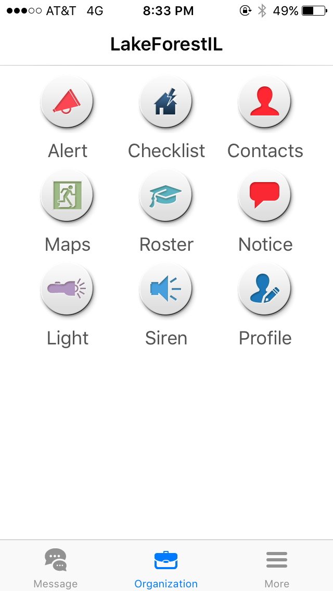
2015-2016: CrisisGo APP

Slide 8
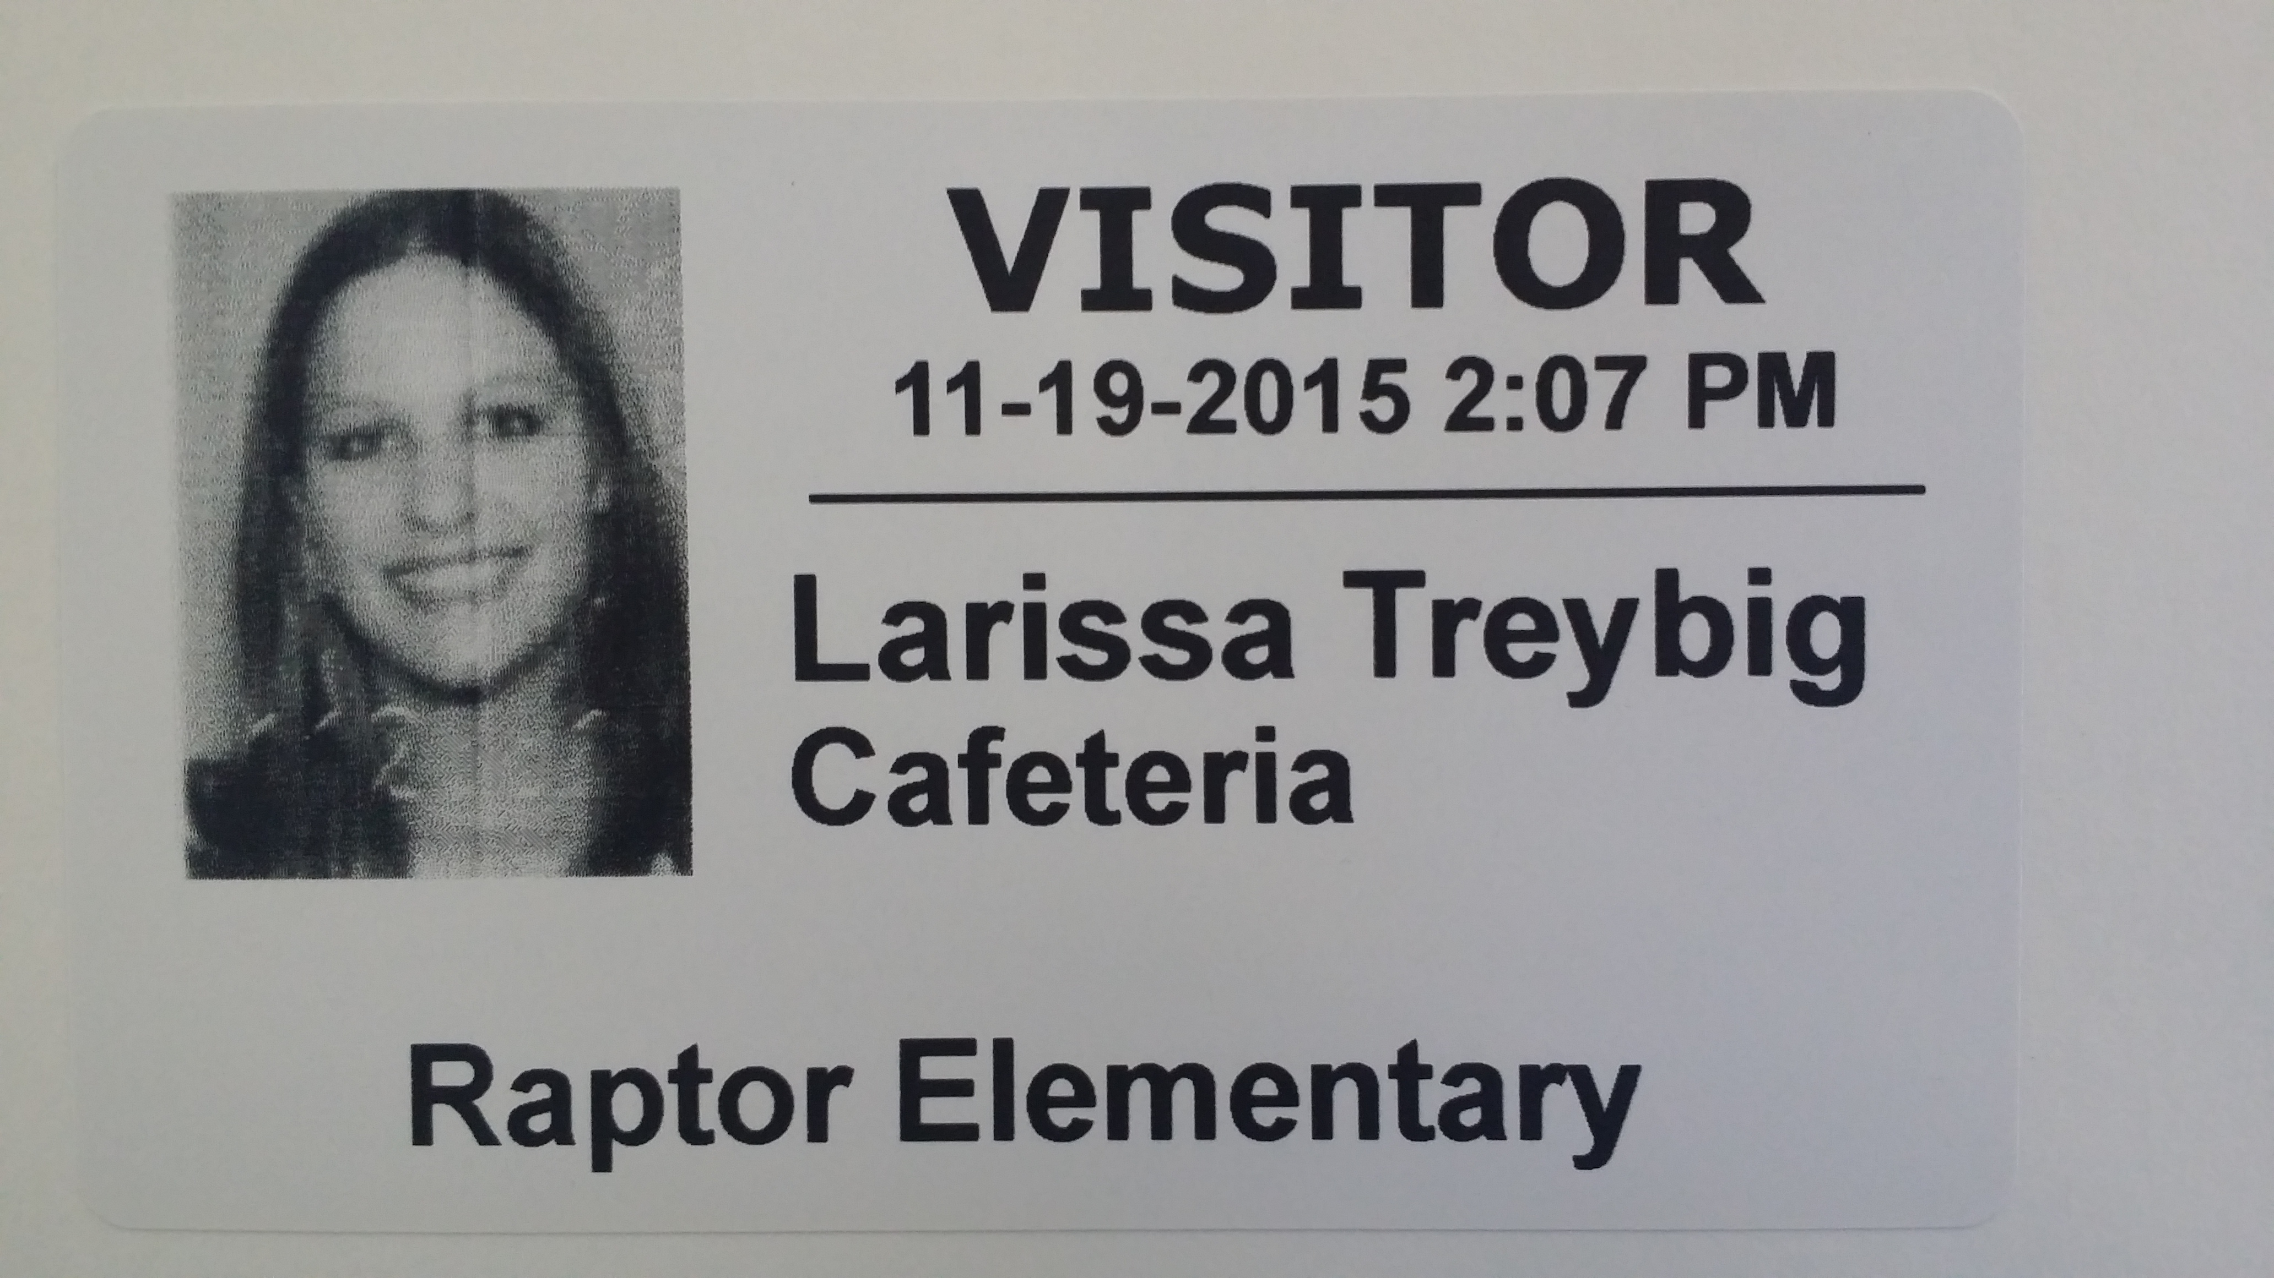
March 2016
Enhanced Visitor Management Protocol
RAPTOR TECHNOLOGIES

